Slide 1
DSI Project 4: West Nile Virus in Chicago
Team:
GAS the Vectors

Slide 2
Introduction - Who are We?
G wen GAS the Vectors
A lfred
S cott
A vector is mathematical construction that conveys direction and magnitude.
A vector is also the term for an organism that spreads a disease such as insects, rodents, etc.

Slide 3
West Nile Transmission Path
West Nile virus lives in birds ➔ Mosquitoes feed on birds
Infected mosquitoes ➔ Bites humans
Key take away: Newly hatched mosquitoes do not carry the virus. They obtain the virus from other animals.

Slide 4
West Nile Virus in Chicago
First human case hits city in 2002
Discovered in horses and birds in 2001
225 confirmed cases in first year
42 deaths reported in Cook County
Chicago leads nation in WNV deaths in 2003
64 deaths
About half of deaths are in people over 60
Only 10% of city population is over 60

Slide 5
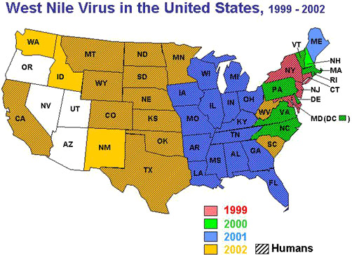
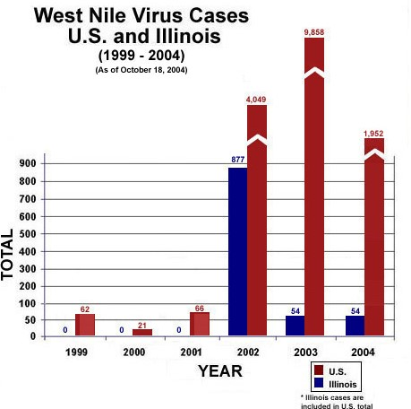
History of West Nile Virus in Chicago

Slide 6
Public Health Impact of West Nile Virus
8 out of 10 are asymptomatic
1 in 5 will have some febrile illness
Head and body ache, joint pain, vomiting, diarrhea, rash
1 of 150 result in serious symptoms (neuroinvasive)
Encephalitis (inflammation of the brain)
Meningitis (inflammation of membranes surrounding brain and spinal cord
1 in 10 result in death

Slide 7
Description of Data
Spray
data from 8 dates of spraying
14,294 observations after data munging
Weather
from 2 stations, for all years
May – Oct; 2007 – 2014
Trap data
2007, 2009, 2011, 2013
10,506 records, ~116,000 predictions requested

Slide 8
Data Cleaning / Interpretation – Key Issues
Spray data
issue with date/time & locations, could infer actual amounts
Traps
one trap had two (long, lat)
Weather
some “M” and “T”, Sunset times of 1860.
50 maximum mosquitoes in a trap per observation

Slide 9
Key Data Elements Over Time – Rain, Mosquitos, and Spray Data
Summer 2007
Summer 2009
Summer 2011
Summer 2013

Slide 10
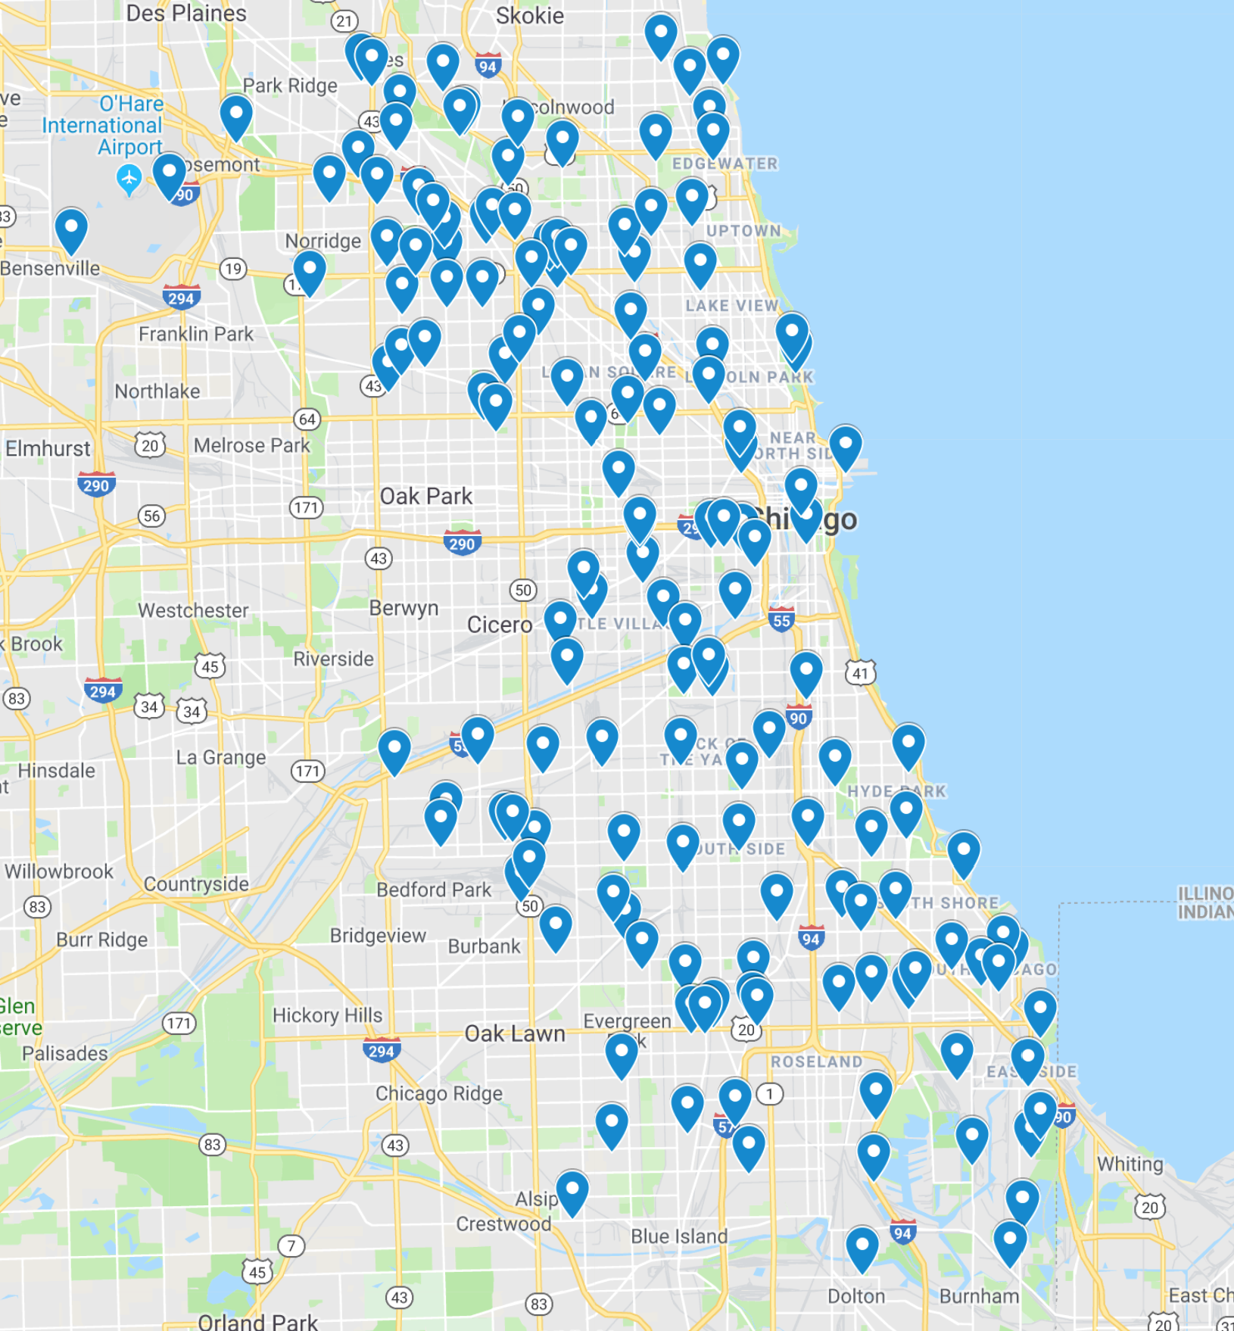
Mapping Traps & Hotspots
Map of All Traps
Map of Hotspots
Traps with higher empirical probabilities of collecting samples that contained West Nile. Shows a hotspot near O’Hare.

Slide 11
Modeling
Overall goal of the modeling is to predict probability of WNV at various locations in Chicago during summer months. This then informs a cost/benefit analysis on prevention.
We first predicted the mosquitos levels expected (as measured in the traps) and then used that information to then predict the probability of the presence of WNV.

Slide 12
Modeling – Key Data Elements Useful in our Models
Longitude and Latitude
The week of the year when observations were made
The type of mosquitoes present in traps
The type of mosquitoes that transmit WNV
Tried clustering because more traps were listed in the test versus tests in the training data. (not useful)
Date since emptied for traps (not useful)
Week of the year was useful
Days since spraying if there was spraying (not robust)
Aggregation of duplicate rows (lost information)

Slide 13
Modeling – Use EDA to estimate P(WNV | (Spec & # in Trap))
Step 1, predict # of Mosquitos
Step 2, look up probabilities from EDA
Could have probably raised the ‘smoothed’ probabilities

Slide 14
Modeling – Predicting Mosquitoes per Trap
8 Regression models: LR was poor, Ridge, Elastinet, Lasso, Random Forrest, Gradient Boosting, AdaBoost
Grid search used to tune hyper-parameters
GradientBoosting was the best model
Forced predictions to fit our range of possible values (negative values to zero, if test had multiple rows, we set value to 50).

Slide 15
Modeling – Predicting Probability of WNV
Used the Mosquito prediction to augement test data.
Then modeled probability of WNV present by:
Classification modeling with: LogisticRegression, KNN, and various decision trees.
All gave relatively good scores
LogisticRegression used as final model
Train/Test split AUC ROC was 78% (not Kaggle score
Only 3 species with non-zero probabilities

Slide 16
Modeling Next Steps
Things we would like to pursue to improve the model.
Expand dataset to include observations where there were no mosquitos found.
Weather data included in prediction models
Length of day using sunrise, sunset information

Slide 17
Cost Benefit Analysis – Neuro and Non-Neuro Invasive Cases
Cases have run as high as 880 per year.
Chicago has 84% of Illinois population.
Source: CDC

Slide 18
Cost Benefit Analysis – Current State / Costs
City of Chicago currently uses Zenvix as of August 2018
Adulticide formulated to also kill larva
Approved in all states except New York
Approved for use on crops and in Urban areas
30 Gallon barrel -- $11,595
At recommended application rate of 0.007 lb/acre
$1,171.20 per sq mile
City of Chicago allocations $5.3 million for mosquito control
On a steady 3% increase year to year

Slide 19
Cost Benefit Analysis – Recommended Areas for Spraying
With the use of our data, we can narrow the optimal areas for increased spraying:
Targeting 45 square miles of Chicago with
Highest occurrences
East of O’Hare to Lake Michigan (16 sq miles)
Heavy traffic
O’Hare Airport (9 sq miles), Lincoln Park area (4 sq miles)
Areas with vulnerable persons
Hospitals and senior centers

Slide 20
Cost Benefit Analysis – Public Health Benefits
Benefit of preventing a case of WNV in humans: $27,000 - $133,000 with a mean of $33,000.
Ref: “Cost effectiveness of a targeted age-based West Nile virus vaccination program” by Shankar, et al. Elsevier public health journal, May 2017
Average number of cases of West Nile in Chicago ~100.
Maximum cost benefit = $3.3m if WNV eliminated

Slide 21
Recommendation
We are recommending that the Chicago Public Health department implement the following measures:
1.Selective Spraying
45 square miles x 25 weeks x 1,170 = $1.3m
Would need approximately 1/3 reduction in cases to be C/B neutral
2.Use of Ovillanta trap
3.Biological Control

Slide 22
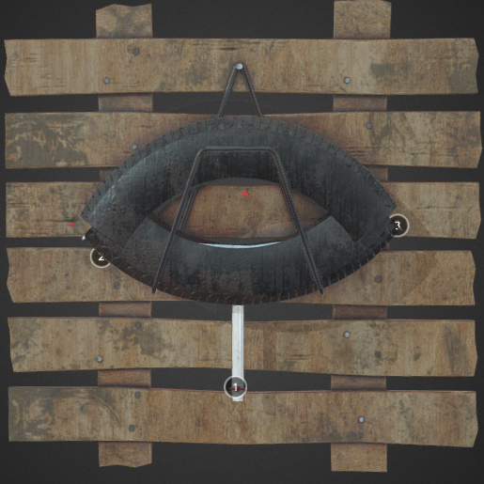
Trapping
Ovillanta
Developed at Laurentian University in Ontario
Cost $3.08
Traps and kills
Self-sustaining

Slide 23
Biological Control
Methods for long term mosquito deterrence
Work with parks department on tree/flower selections
Permanent incorporation of plants that repel mosquitos
Marigold, citronella, lavender, Eucaluptus
Work with Wildlife & Watershed Management on species control, incorporate
Dragonflies, bats
Koi and Carp
Mosquito Sterilization – Tap into Federal Efforts

Slide 24
Thank you for your time
Questions?

